Slide 1

Employee Attrition & The Wage Gap
Bradshaw, Vincent, Eddy
Notes:
Will

Slide 2
Team members
Mike Bradshaw
Team lead. Analysis on gender wage gap. Academic: M.A. Candidate, Industrial and Organizational Psychology – East Carolina University Career: Data analyst, Shaker
Assistant data analyst, Student Affairs Assessment, Research and Planning
Cameron Vincent
Data screening and preparations. Statistical analyses. Academic: M.A. Candidate, Industrial and Organizational Psychology – East Carolina University Career: Co-op in HR, BSH Home Appliances
Teaching Assistant, Statistics and Research methods
Artist
Will Eddy
Analyses to identify predictors for attrition variable. Academic: M.A. Candidate, Industrial and Organizational Psychology – East Carolina University
Career: Assistant, Methodology and Research Lab, ECU
Certified Trainer, Vitamix corporation
Notes:
Will

Slide 3
The goals
Examine simulated IBM HR Dataset
Identify primary factors related to employee attrition
Evaluate relationship of compensation and gender/sex
Notes:
Will
We want to say “WHY” these goals in the audio here – relevant to real world business, save companies money, reduce discrimination, timely goals, high pain points for many companies, etc etc

Slide 4
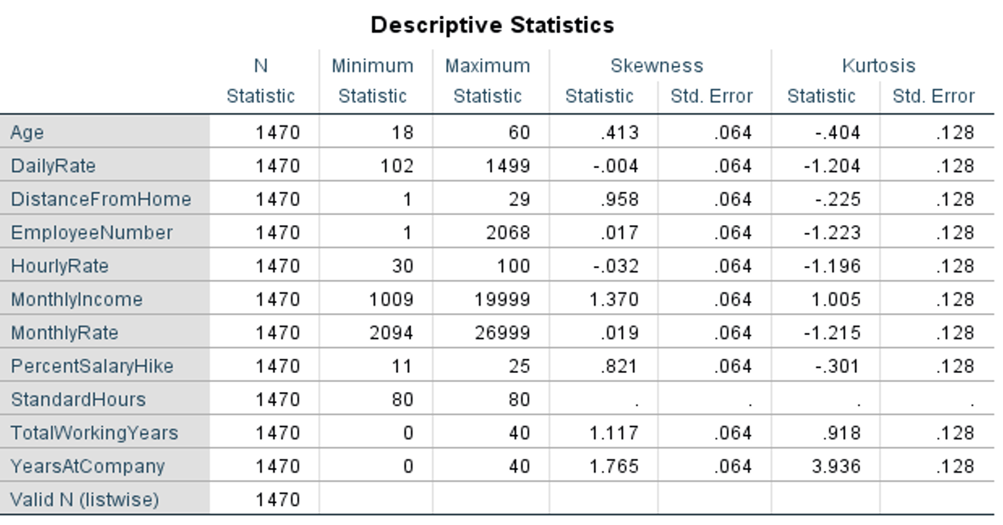
IBM HR dataset
Simulated but with real-world patterns
No missing data.
No extreme skewness.
Few outliers.
Notes:
Cameron
Data Set Origin
Descriptive Characteristics

Slide 5
What caused attrition?
Research Question 1: What employee factors significantly contribute to predicting employee attrition?
Notes:
Cameron

Slide 6
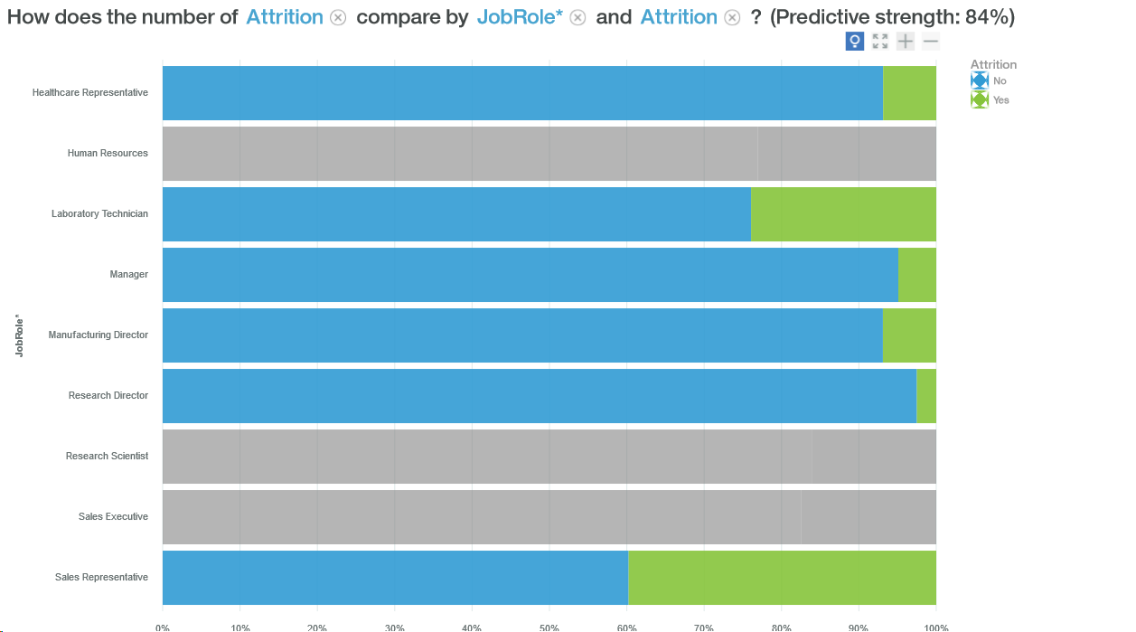
Logistic regression
Those with Overtime were more likely to stay than those without.
Those with Human Resources, Laboratory Technicians, Research Scientist, or Sales Executive Job Roles were more likely to stay than other roles.
Those whose Marital Status was Married were more likely to stay than those who were Divorced.
Those with high Job Involvement level were more likely to stay compared to those with low levels.
Those who experienced more Business Travel were more likely to stay than those with Rare or No Travel.
Notes:
Will

Slide 7
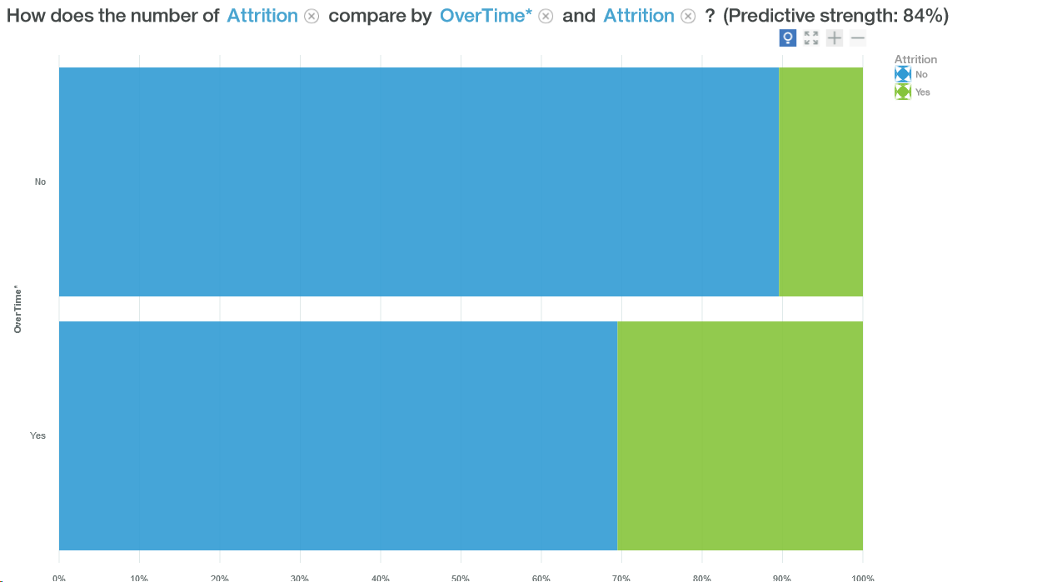
Notes:
Will

Slide 8
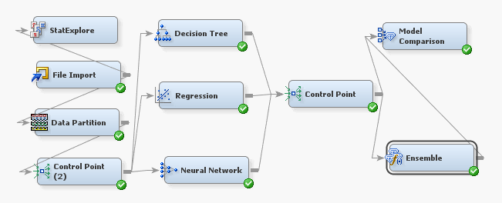
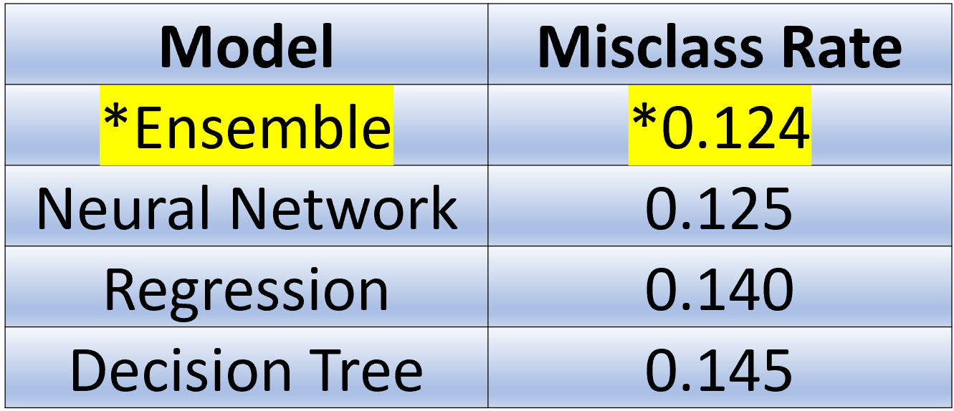
Methodology
Research question 1, SAS Enterprise Miner
Logistic Stepwise Regression
Neural Network
Decision Tree
Ensemble Model
Models compared on validation set misclassification rate
Employed varying levels of inclusion criteria for variables. Ultimately used rule: Pr > χ² < .001, then used this set of variables for all models
Notes:
Cameron

Slide 9
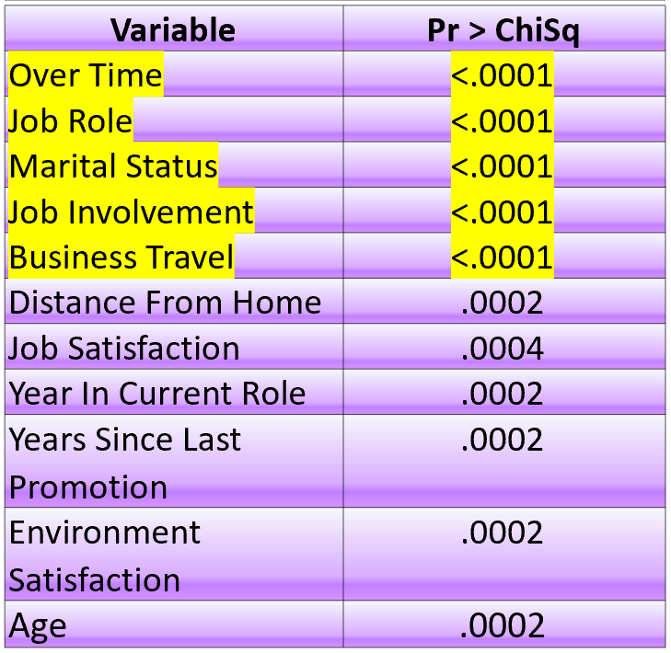
Ensemble Model Results
Those with Overtime were more likely to stay than those without.
Those with Human Resources, Laboratory Technicians, Research Scientist, or Sales Executive Job Roles were more likely to stay than other roles.
Those whose Marital Status was Married were more likely to stay than those who were Divorced.
Those with high Job Involvement level were more likely to stay compared to those with low levels.
Those who experienced more Business Travel were more likely to stay than those with Rare or No Travel.
Model | Misclassification Rate
Ensemble | 0.124
Notes:
Cameron

Slide 10
Examining the gender wage gap
Research Question 2: Is there any statistical evidence for a gender wage gap amongst comparable employee groups?
Notes:
Mike

Slide 11
Methodology
Research question 2, Excel data analysis add-on
Randomized list-wise deletion of cases to make equal sample sizes for comparison groups
T-tests used for group comparisons
Notes:
Mike

Slide 12
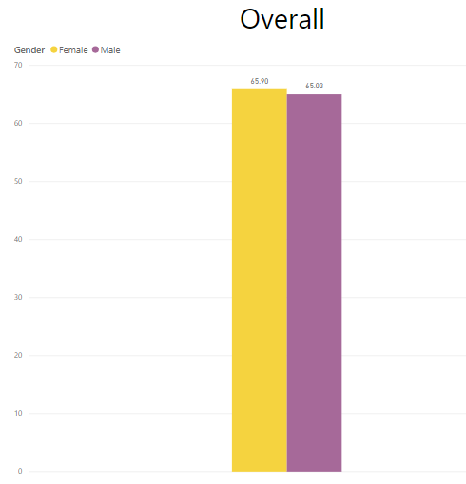
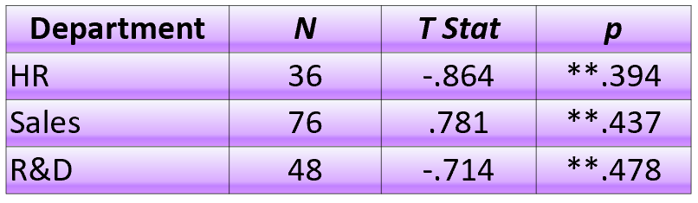
Results
Women make slightly more, but not a statistically significant difference in the simulated data
Notes:
Mike

Slide 13
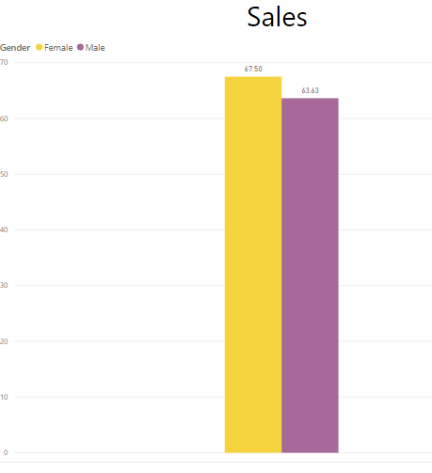
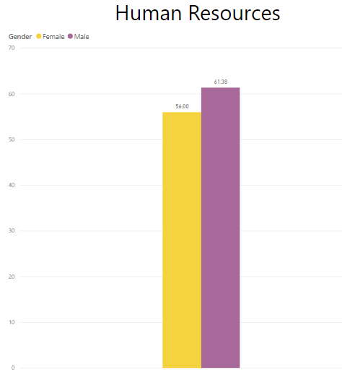
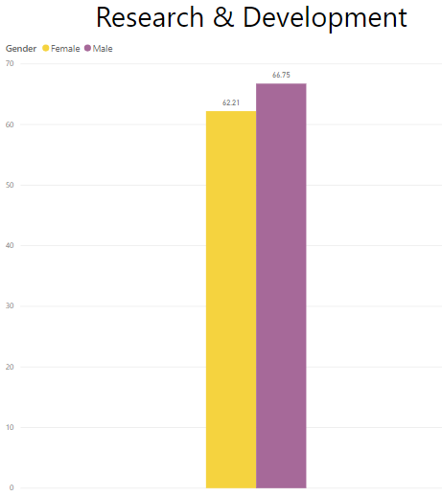
Female – Yellow
Male - Purple

Slide 14
Conclusions
Attrition
Overtime status is highly predictive variable. One could focus on strategically managing overtime policies and allotments.
Job involvement ratings should be monitored and improved to increase attrition.
Business travel should be as widely distributed as possible
Wage gap
Mean income for women was higher than men in one of the three departments measured, but mean pay was higher overall. There were no statistically significant differences in income earned between genders. The simulated data may not include a realistic picture of wage-gap.
Future research
These analyses should be conducted using real HR data. Gender-wage gap can be examined using more complex statistical techniques. Interventions should be geared towards utilizing variables that are highly predictive of attrition with respect to ones company.
Notes:
Mike

